Slide 1
The hoop that never misses
Caitlin Welch

Slide 2
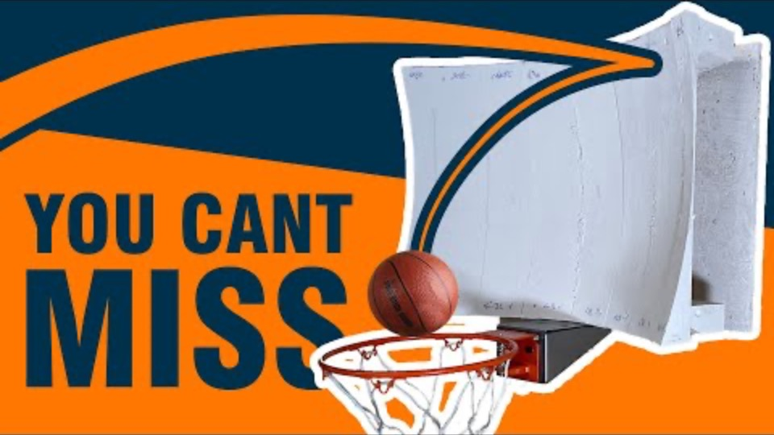
The problem
Based off a YouTube video from “Stuff Made Here”
Build a curved backboard so that the ball will always go in the hoop after hitting the backboard
Notes:
- Embed clip of video

Slide 3
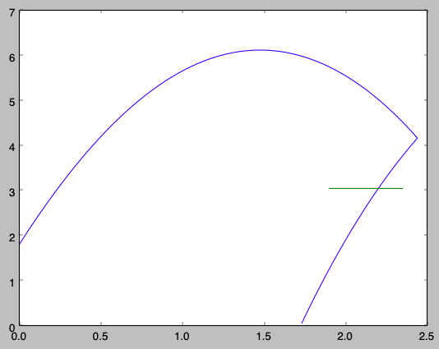
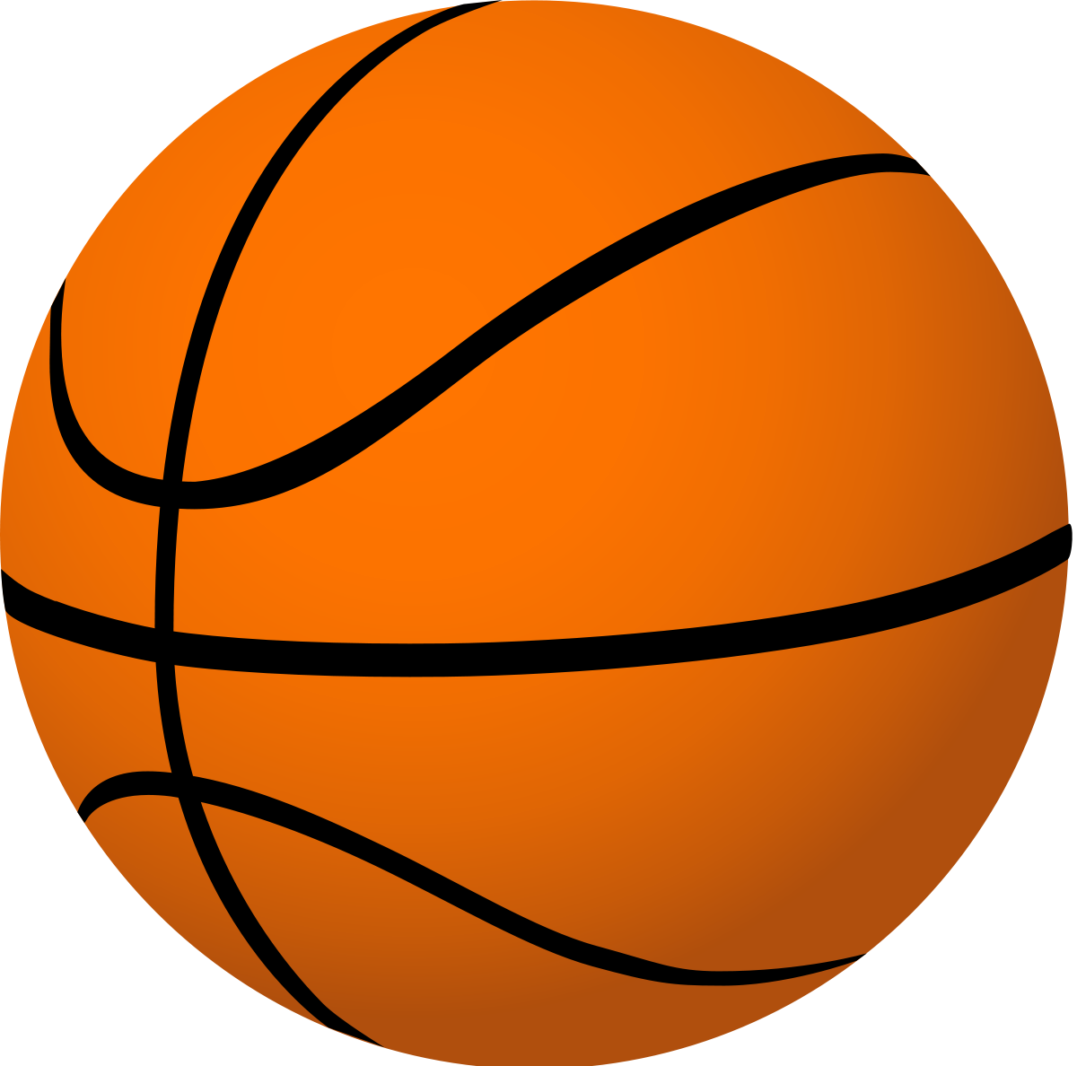
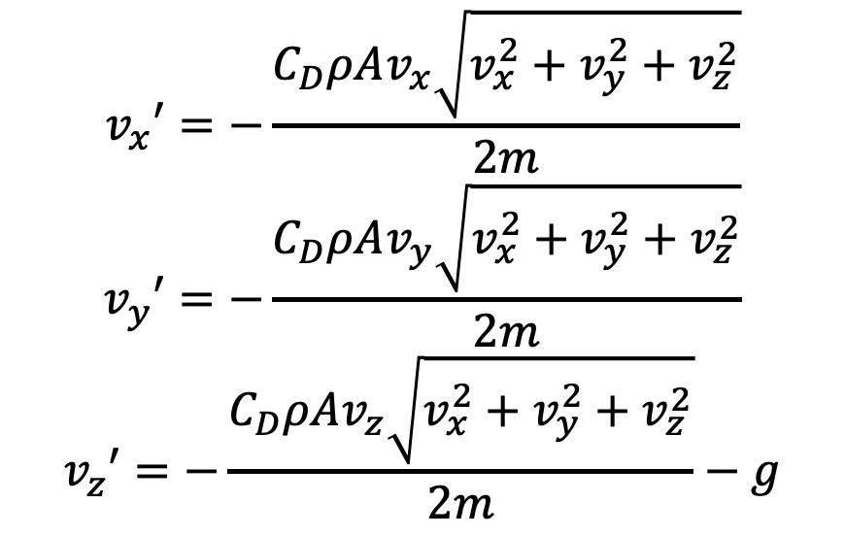
model
Forces on ball: gravity and air resistance – neglected Magnus force and buoyant force
Wilson basketball: 22oz, 29.5” circumference
v_{y}
$$v_{x}′=−\frac{C_{D}ρAv_{x}\sqrt{v_{x}^{2}+v_{y}^{2}+v_{z}^{2}}}{2m}$$
$$v_{y}′=−\frac{C_{D}ρAv_{y}\sqrt{v_{x}^{2}+v_{y}^{2}+v_{z}^{2}}}{2m}$$
$$v_{z}′=−\frac{C_{D}ρAv_{z}\sqrt{v_{x}^{2}+v_{y}^{2}+v_{z}^{2}}}{2m}−g$$
F_{D}
F_{g}
Notes:
Forces on ball: gravity, air resistance – we neglected the magnus force (looked at existing research and found that spin is not a factor with modelling a basketball shot) and buoyant force
Air resistance is dependent on the air density and also the cross-sectional area of the ball
Talked to the men’s basketball coaches about basketballs to base the model of a real ball we could use and learned that they are nonstandard, so we chose the most common NCAA basketball brand: Wilson, 22oz and 29.5” circumference

Slide 4
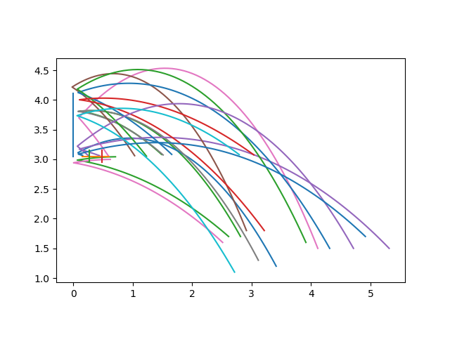
methods
Modified RK4 ODE solver for the trajectory of the basketball
Used Monte Carlo optimization for finding ideal backboard
v_{y}

Slide 5
results

Slide 6
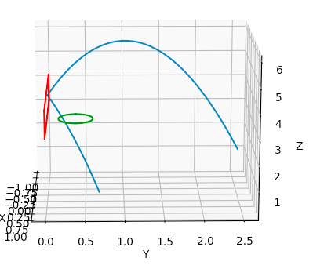
trajectory
z
y
x
v_{y}
v_{y}
Notes:
Draw direction of motion for ball

Slide 7
Random shots
v_{y}
Notes:
Y range: 0.5 to 7.5m
Z range: 1.5 to 2m
Initial velocity range: 6 to 10m/s
Initial angle range: 90 to 180 degrees

Slide 8
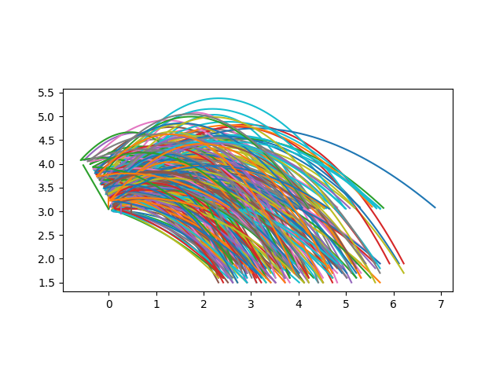
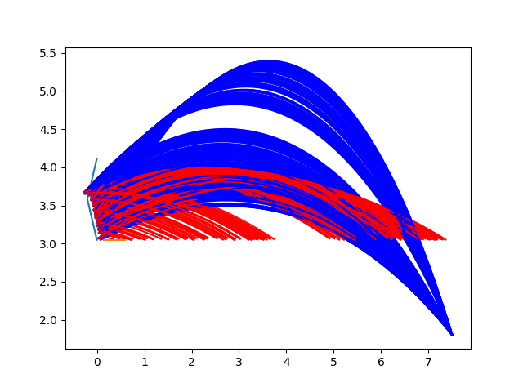
2 point backboard
3 point backboard
Notes:
Various problems I ran into were the ball hitting the top side of the backboard when the angle of the backboard was less than 90 degrees, figuring out the component velocities after collision with backboard
Explain rebound colours
Backboard y values range between -0.5 and 0.5m
Highlight three points that are moving
Use mouse to show where the backboard is

Slide 9
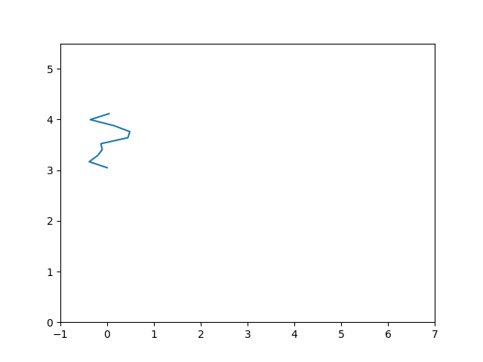
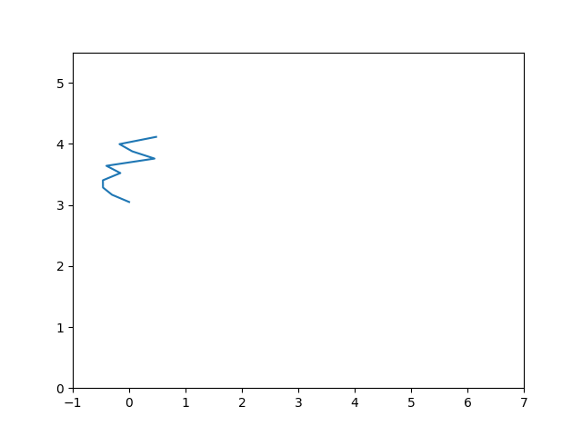
10 point backboard
Notes:
10 point backboard, 100 shots, 100 backboards
Computationally intensive – took 10 hours to run

Slide 10
Future work
Find the optimum backboard for 10 point backboard
Extend to more than 10 points
Introduce energy lost when hitting the backboard?
Extend to 3D
Notes:
Machine 2D backboard as initial test before extending to 3D (would be an extended 2D backboard), eventually machine 3D backboard
Do we need to take energy into account for an accurate model – experimentally using 2D backboard

Slide 11
acknowledgements
Thank you to Dr. Michelle Kuchera and Dr. Chartier for leading this independent research. I’ve also worked periodically with Michael Blackmon from T&I regarding submitting the file through Jupyter and using SLURM.

